Slide 1
The Secret to Happiness

Slide 2
Healthcare Quality & Happiness
Group 1: Neelam Patel, Tina Huang, Victoria Grose, & Vadym Zhukhovytskyy

Slide 3
The Happiness Report
The World Happiness Report calculates a “happiness score” based on surveys in 156 different countries
This report is increasingly used to inform policy decisions and assess the progress of nations
We sought to investigate these happiness scores and how they might correlate with factors traditionally seen as related to happiness

Slide 4
Our Project
The link between health and happiness is one of the best-documented in the study of well-being.
In this study we want to examine how much a country’s healthcare system, including access to care, affordability, and quality of care affects the country’s overall level of happiness.
What is the relationship/correlation (if any) between healthcare quality and happiness?

Slide 5
Questions
Where are people happiest?
Do happier people have better access to healthcare resources?
Do happier people spend more or less on healthcare?
Do happier people have lower rates of suicide?

Slide 6
Questions
Where are people happiest?
Western Europe
Do happier people have better access to healthcare resources?
Yes
Do happier people spend more or less on healthcare?
More
Do happier people have lower rates of suicide?
No

Slide 7
Questions
Essentially, we aimed to examine the potential relationships between healthcare expenses, access to healthcare resources, suicide, and happiness
Healthcare expenses include private healthcare expenditure, government healthcare expenditure, out of pocket healthcare expenses, and average healthcare expense.
Healthcare resources include physicians, nurses, hospital beds, and community health workers.
Suicide factors include female, male, and overall suicide rate
Other residual factors analyzed include life expectancy and alcohol consumption

Slide 8
Questions
We were able to answer these questions mostly to our satisfaction
All happiness data was found in the World Happiness Report
We needed information on healthcare resources and expenditures
This was found via the World Bank and World Health Organization

Slide 9
Data Cleanup & Exploration
World Happiness Index, The World Happiness Report, 2015-17.
From the raw csv data, columns of interest were selected (happiness rank, score, economy, and life expectancy). Datasets from all three years were merged, and average happiness, GDP, and life expectancy over 2015-17 were calculated. Dropna was used to get rid of entries that don’t contain complete datasets. Final cleaned up data represents average happiness score, economy, and life expectancy for each country in 2015-17.
World Medical Expense, Global Health Expenditure Database from the World Bank
We want to examine the effect of long-term medical expenditure on happiness level. The raw data file contains healthcare expenditure from years 2005-15. Average medical expenditure over these 10 years (in %GDP) was computed and merged to the happiness index data frame. Dropna was used to get rid of entries that don’t contain complete datasets
Healthcare Resources, World Development Indicators from the World Bank.
From the raw datafile, data from years 2015-17 were selected to match the timeframe of happiness index data. Sum of data was calculated and indicators of interest was selected (number of physicians, nurses/midwives, healthworkers, and hospital beds per 1000 people). Cleaned data was merged to main dataframe.

Slide 10
Data Cleanup & Exploration
Global Health Expenditure Database (World Health Organization)
There was not much cleaning needed for these data files as the source allowed one to choose the factors they wanted to look at. Government Health, Private Health, and Out of Pocket expenditure per capita (PPP Intl$) were chosen for the years of 2015 and 2016.
“Purchasing power parity (PPP) is an economic theory that compares different countries' currencies through a "basket of goods" approach. According to this concept, two currencies are in equilibrium or at par when a basket of goods (taking into account the exchange rate) is priced the same in both countries” Investopedia
After read the csv files into the notebook, the files were merged with the Happiness files to create the final data frame.

Slide 11
Data Cleanup & Exploration
World Population Review, 2015; World Population, 2016; Review World Population Review, 2019
List of countries by suicide rate – Wikipedia, 2016
"Suicide rates, age standardized - Data by WHO Region". WHO (archived on 17 Jan 2018). 2015. Archived from the original on 17 January 2018. Retrieved 13 April 2017.

Slide 12
Data Cleanup & Exploration
Country names were not always consistent
There was not data available for every country that we were interested in; some datasets were so sparse as to be essentially meaningless
Some datasets only provided data to 2016
The code wasn’t reading values from the expenditure files as integers. The chart created showed a downward trend with each point having its own tick on the x-axis.

Slide 13
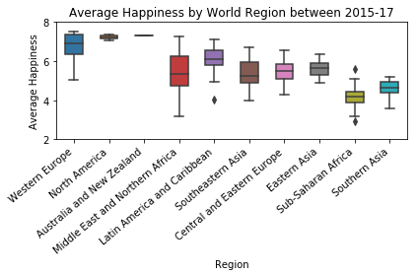
Data Analysis
A box plot was created to visualize the relative happiness of each continent.
Western Europe has the highest level of happiness and Sub-Saharan Africa has the lowest.

Slide 14
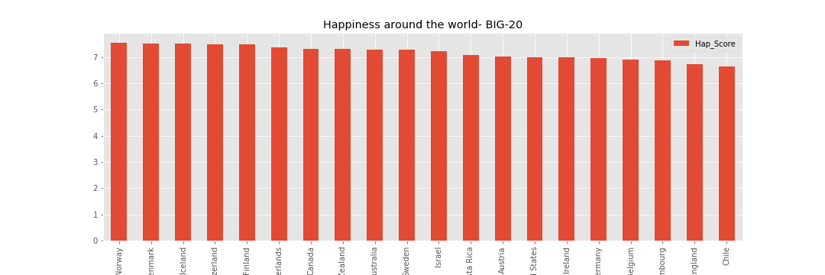
Data Analysis
There is a large difference in happiness index across twenty of the most developed countries in the world.
Nordic countries have the highest ranking: Finland, Iceland, Netherlands, the Norway and Denmark have the highest scores (all with average above 7).

Slide 15
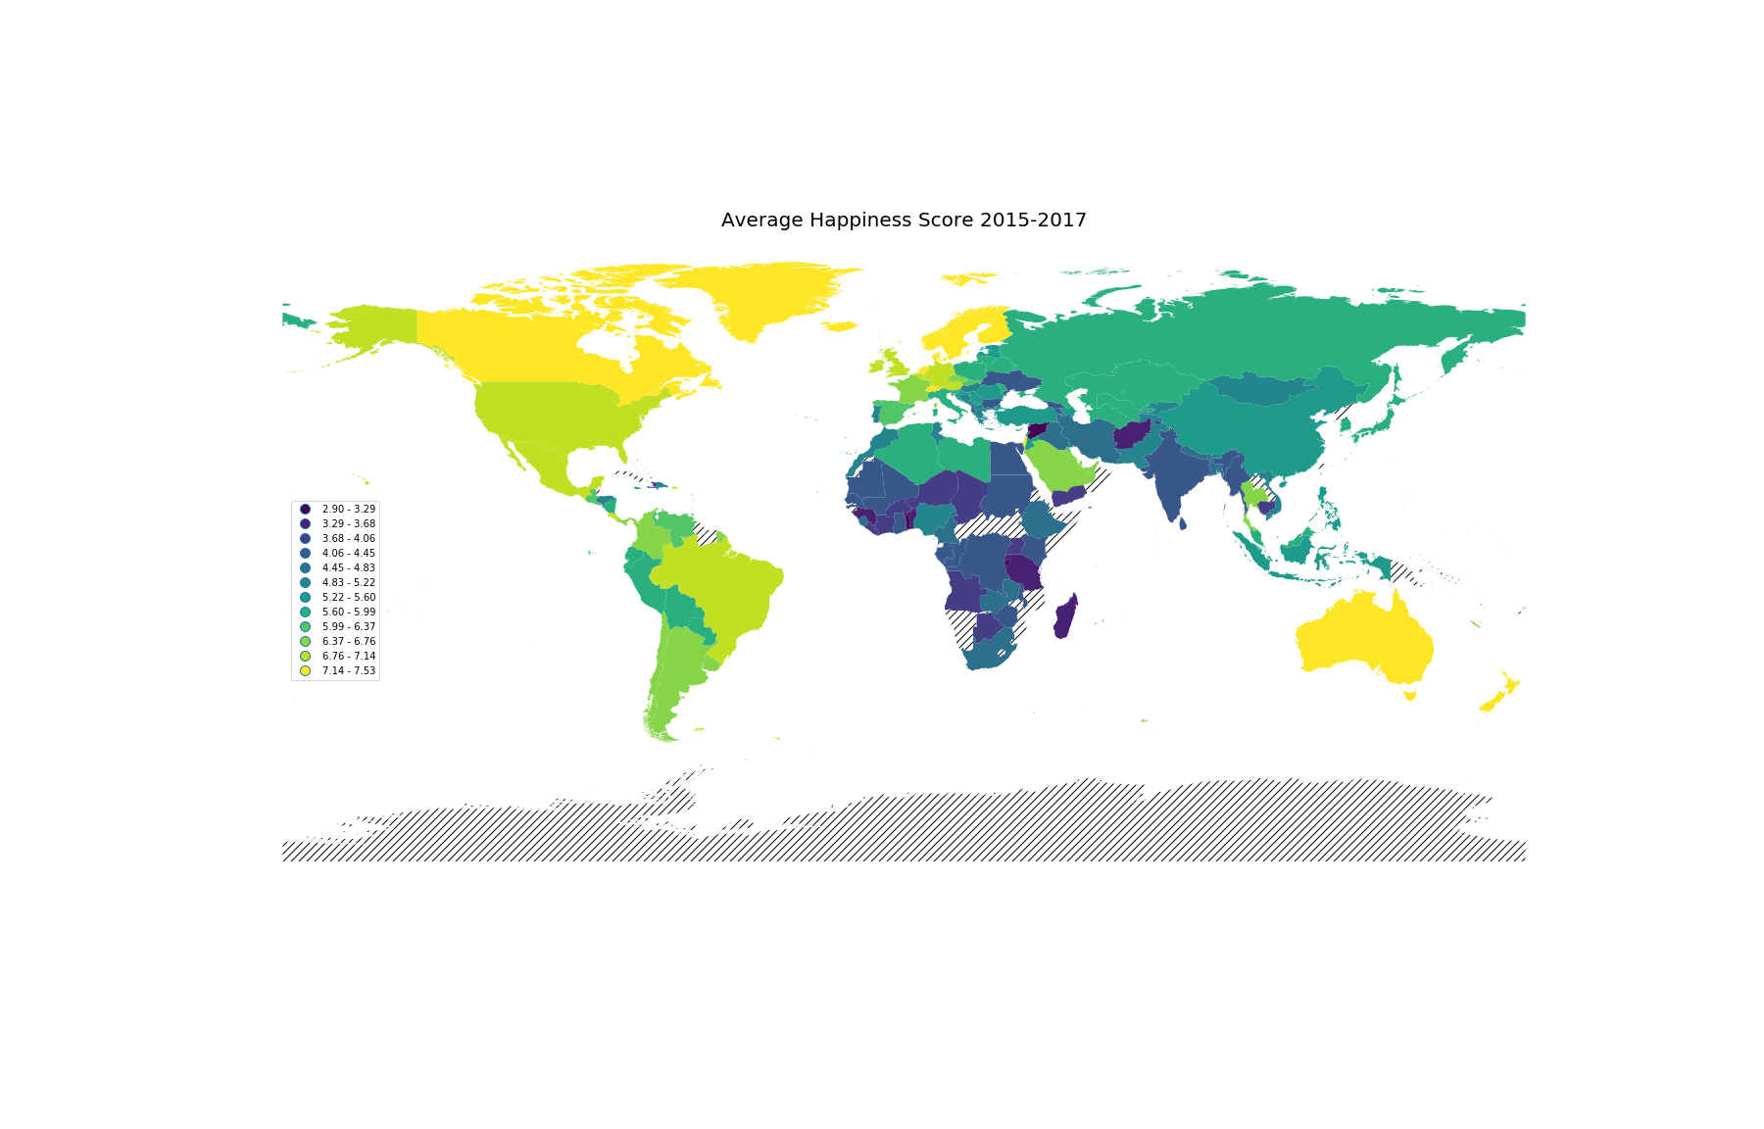
Data Analysis

Slide 16
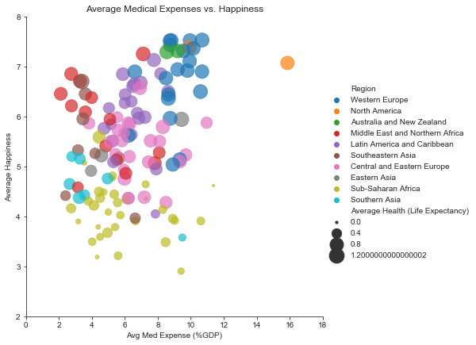
Data Analysis
This illustrates the relationship between three variables: average medical expenses (x), average happiness (y), and average life expectancy (bubble size).
Life expectancy and happiness seem to correlate positively with average medical expense
The USA is a clear outlier

Slide 17
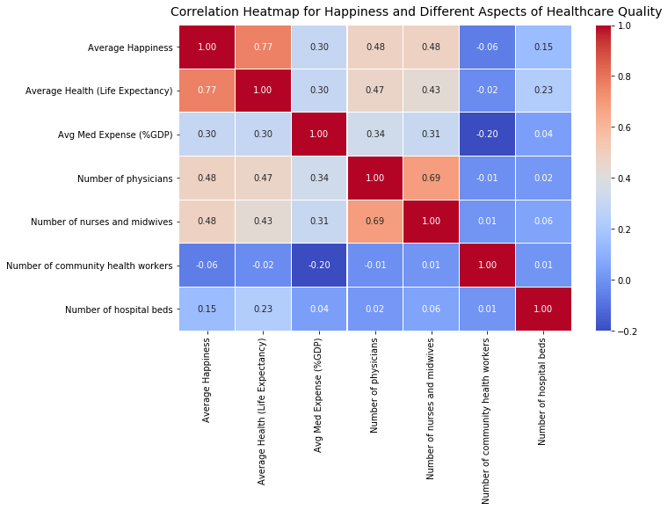
Data Analysis
A correlation heatmap was created to provide a broad overview of which aspects / indication of health care quality has the strongest correlation with happiness level.

Slide 18
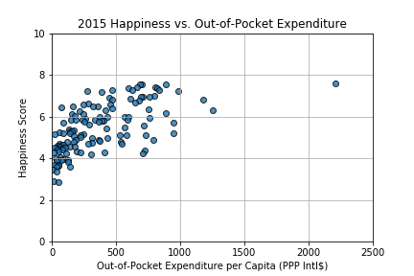

Data Analysis
Scatterplots were created comparing out-of-pocket healthcare expenditure with happiness for 2015 and 2016 data.

Slide 19
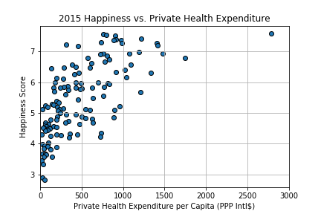
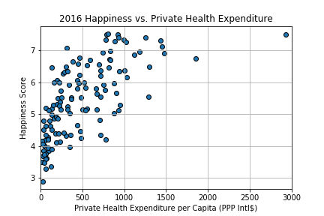
Scatterplots were created comparing happiness and private healthcare expenditure and happiness for 2015 and 2016 data.
Data Analysis

Slide 20
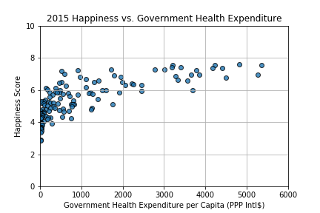
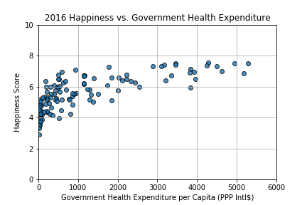
Scatterplots were created comparing happiness and government healthcare expenditure and happiness for 2015 and 2016 data.
Data Analysis

Slide 21
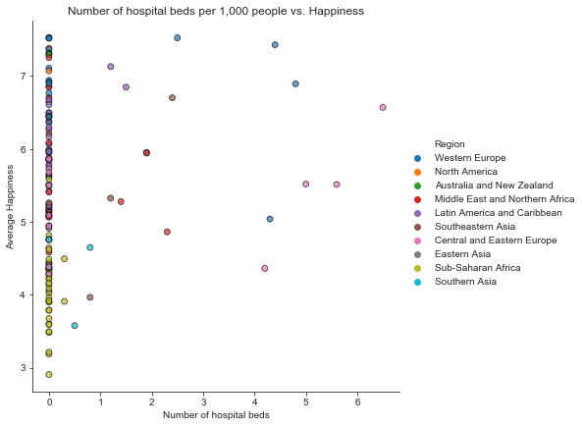
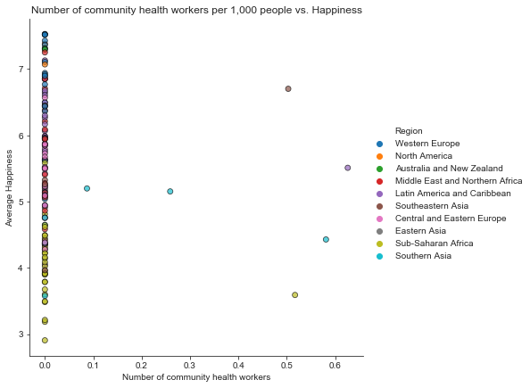
Data Analysis
Scatterplots were created comparing number of hospital beds and number of community health workers per 1,000 people and happiness, color-coded by region
Unfortunately, there are a lot of missing values here and this comparison is inconclusive as a result.

Slide 22
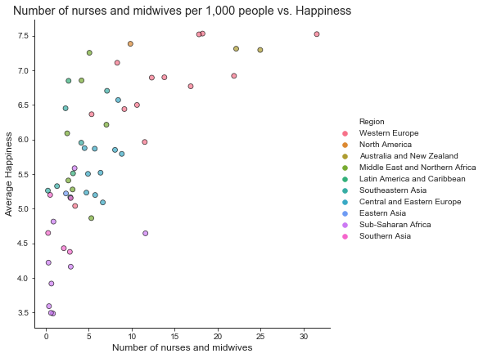
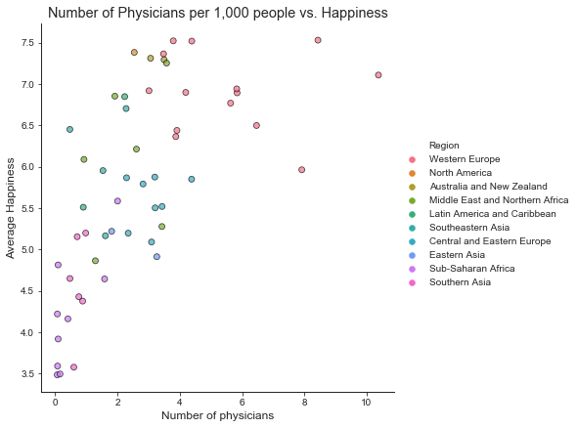
Data Analysis
Scatterplots were created comparing the number of nurses/midwives and the number of physicians per 1,000 people and happiness, color-coded by region
There is a visible correlation between the amount of healthcare workers and happiness score.

Slide 23
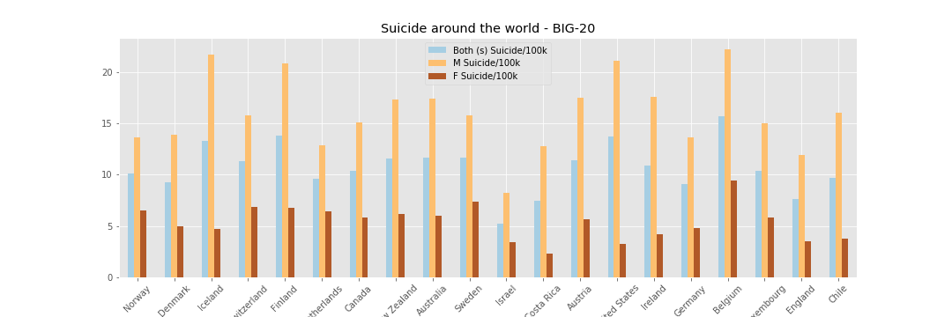
Data Analysis
The twenty countries with the highest happiness scores show less similarity in suicide rates.

Slide 24
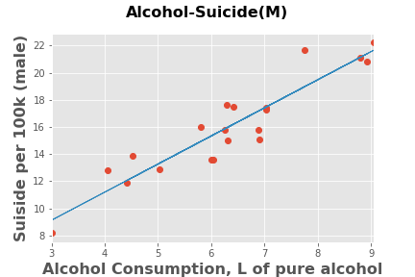
Data Analysis
Suicide is more strongly correlated with alcohol consumption than with happiness scores

Slide 25
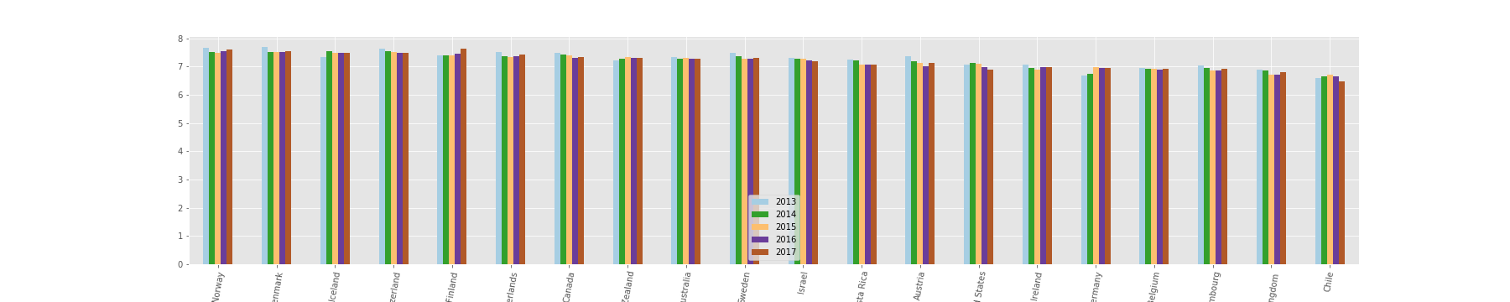
Richer countries tend to have higher average happiness levels; and across time, most countries that have experienced sustained economic growth have seen increasing happiness level.
Data Analysis

Slide 26
Discussion
Happiness is highest correlated with life expectancy (r=0.77). Both measures are highest in Western Europe and lowest in Sub-Saharan Africa.
Availability of medical care is the second highest correlate with overall happiness. Of the 4 aspects of healthcare quality we examined, number of physicians and nurses/midwives per capita correlated positively with happiness (r=0.48). This suggests that availability and accessibility of medical resources contributes to overall happiness. High medical expense does not necessarily leads to lower happiness (r=0.3) or longer life expectancy (r=0.3).
Lowest happiness level is observed in a Sub-Saharan country with low life expectancy and relatively high medical expenditure (~9.5% GDP). Additionally, the health care expenditure in the United States (far right orange bubble) is not proportional to the happiness and life expectancy. High medical expenditure does not necessarily lead to higher medical quality, higher life expectancy, or higher overall happiness.

Slide 27
Discussion
The results do not demonstrate clear relationship between happiness and suicide. At the same time we can see that most countries listed below report a higher male suicide rate, there are about 3 male suicides out of 4, or a factor of 3:1 (for example, in the United States was 3.36 in 2015, and 3.53 in 2016).
Per the World Health Organization (WHO), approximately 2.5 million deaths are caused by alcohol every year. ... As of 2014, the global average of alcohol consumption is approximately 6.2 liters per person per year. Each of the top twenty countries for per capita alcohol consumption surpass the global average.
Our results do not establish any relationship between happiness and alcohol consumption among twenty developed countries. At the same time we can make a clear conclusion that alcohol consumption is a cause of increasing number of suicide in men (coefficient of determination (r-squared) equals 0.863732829587204).

Slide 28
Discussion
Countries that spend more on health per capita, are happier. However, many countries that spend less on health are also very happy.
We can infer that more money spent on health could lead to better health which in turn could potentially lead to more happiness, but this data is not conclusive of that theory.
There are outlying countries that spend far more on health than the others. Their happiness scores are fairly high; however, based on the other points on the plot, the amount they are spending on their health is not a defining factor of their happiness.
Switzerland spent the most on private health and out of pocket in 2015 and 2016; they also have the highest happiness score

Slide 29
Discussion
There were trends that our data eluded to, but did not completely demonstrate.
The correlation between private expenditure on healthcare and happiness scores is likely more indicative of an underlying correlation between income and happiness

Slide 30
Post Mortem
We would love to find data specifically for access to healthcare, or look more closely at countries for which there is data to better examine the effects of higher health care costs.
Taking the data analyzed about healthcare expenditure and suicide rate and further break it down by region.
We looked at lie expectancy, but it would be also interesting to look at compare disease rates and happiness scores (i.e. are happier people healthier?)

Slide 31
Questions?

